Slide 1
SWITCH
Switches are key building blocks for any network. They connect multiple devices, such as computers, wireless access points, printers, and servers; on the same network within a building or campus. A switch enables connected devices to share information and talk to each other
Repeater
Functioning at Physical Layer. A repeater is an electronic device that receives a signal and retransmits it at a higher level and/or higher power, or onto the other side of an obstruction, so that the signal can cover longer distances.
Repeater have two ports, so cannot be used to connect for more than two devices
Router
Router: A router is an electronic device that interconnects two or more computer networks and selectively interchanges packets of data between them. Each data packet contains address information that a router can use to determine if the source and destination are on the same network, or if the data packet must be transferred from one network to another. Where multiple routers are used in a large collection of interconnected networks, the routers exchange information about target system addresses, so that each router can build up a table showing the preferred paths between any two systems on the interconnected networks.

Slide 2
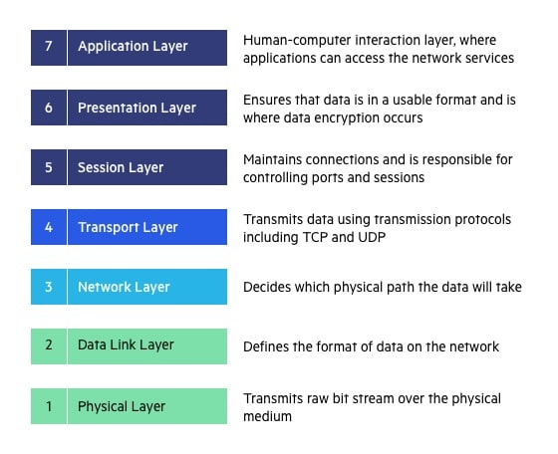
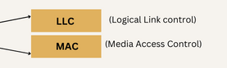
What is Open Systems Interconnection Model?
Upper Layer
Heart of OSI
Lower Layer

Slide 3
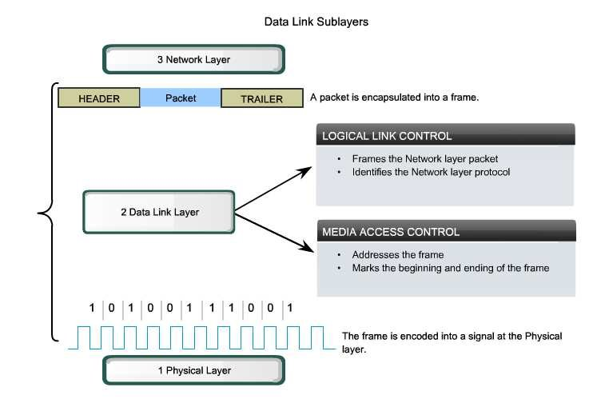

Slide 4
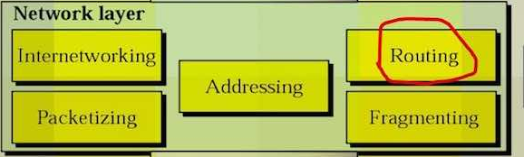
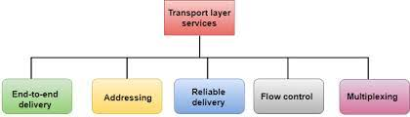

Slide 5
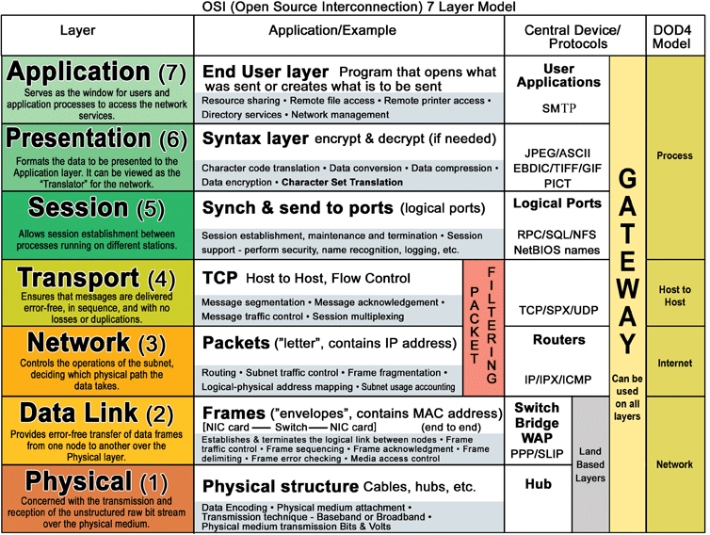

Slide 7
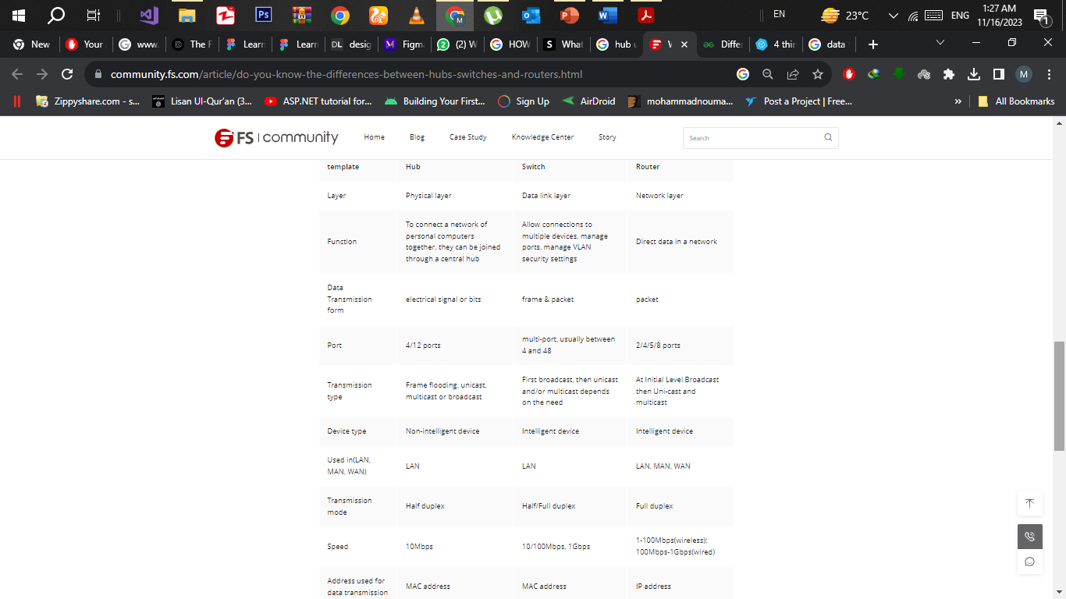

Slide 8
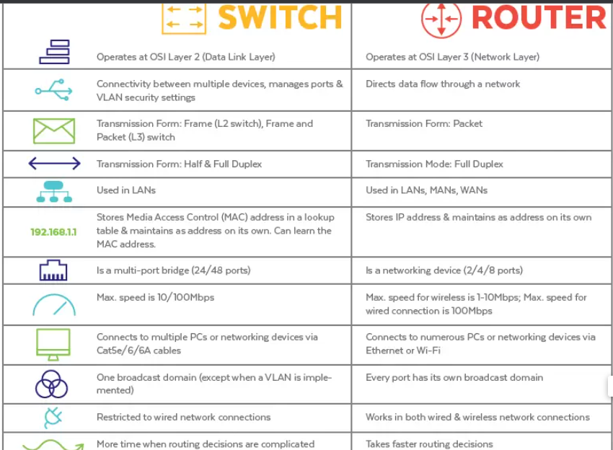
Switch vs. Router: What is the Difference?

Slide 9
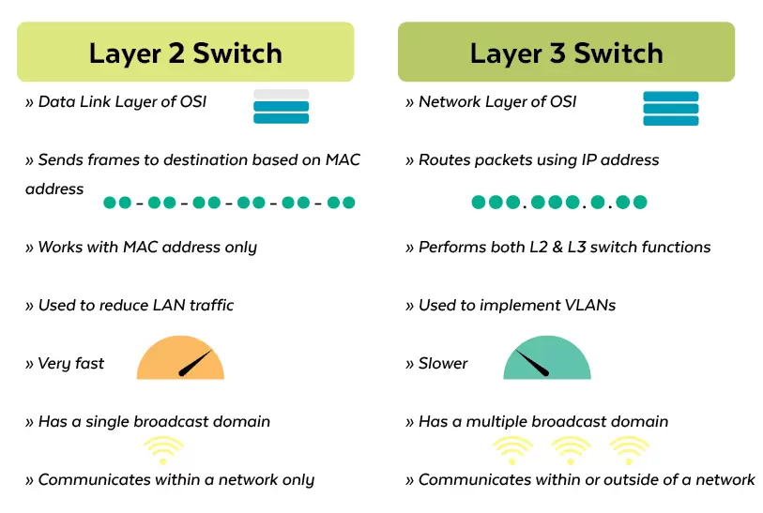
How VLANs work. A VLAN is identified on network switches by a VLAN ID. Each port on a switch can have one or more VLAN IDs assigned to it and will land in a default VLAN if no other one is assigned. Each VLAN provides data-link access to all hosts connected to switch ports configured with its VLAN ID.

Slide 10
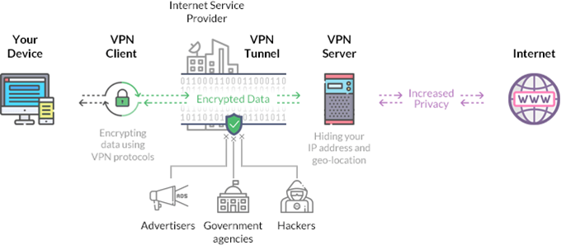
A network controller collects and analyzes network traffic to proactively detect any potential issues before they become real problems. It can perform root-cause analysis and alert IT operations who can take corrective and preventive steps to ensure network services always remain available.
In computing, a firewall is a network security system that monitors and controls incoming and outgoing network traffic based on predetermined security rules. A firewall typically establishes a barrier between a trusted network and an untrusted network, such as the Interne

